Slide 1
MyPAM Mid-Level Controller and Game Development
Mitchell Cottam – Mechatronics
Helcias Ribeiro – Computer Science
Will Atkins - Mechatronics

Slide 2
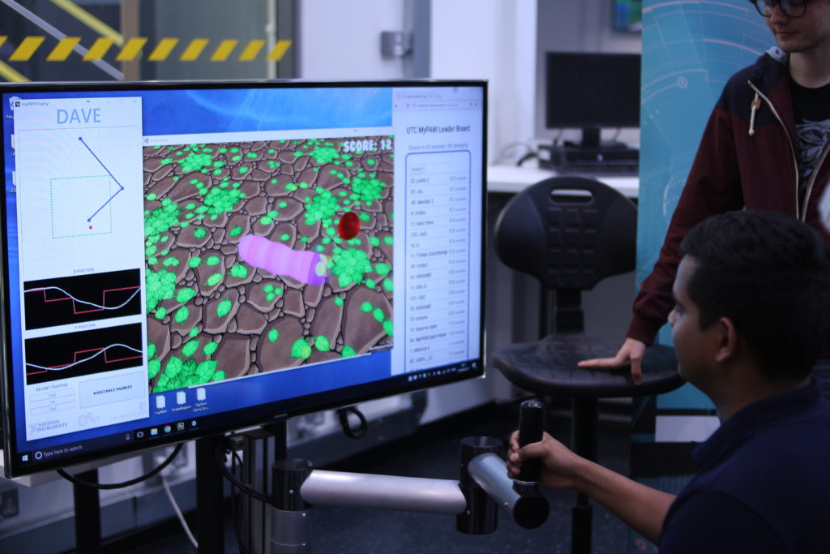
The Objectives of the MyPAM Project
Maximise patient recovery
Increase accessibility of rehabilitation
Reduce monotony of exercises
Maintain long term patient engagement
Increase potential to tailor exercises to the patient
Notes:
The key objective of the myPAM project is to maximise the recovery of stroke survivors – and patients affected by other neurological conditions.
A big problem with rehabilitation is the lack of patient access to therapists due to various logistical difficulties. We aim to keep the myPAM low cost so that it can be installed into the patients home for the duration of their therapy.
Another major problem is patient nonadherence with therapy. They have to keep doing their exercises at home for many months to maximise their recovery, but these exercises are boring, repetitive, and patients often lie to their therapists about their participation. myPAM aims to reduce this monotony using computer games.
The system will also be able to track and log sessions so that participation is monitored, and so the therapist can review their sessions and tailor the experience for them.

Slide 3
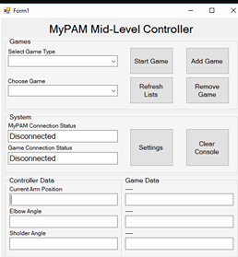
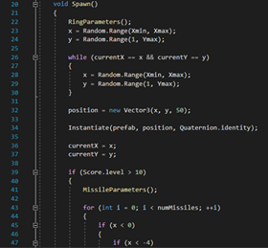
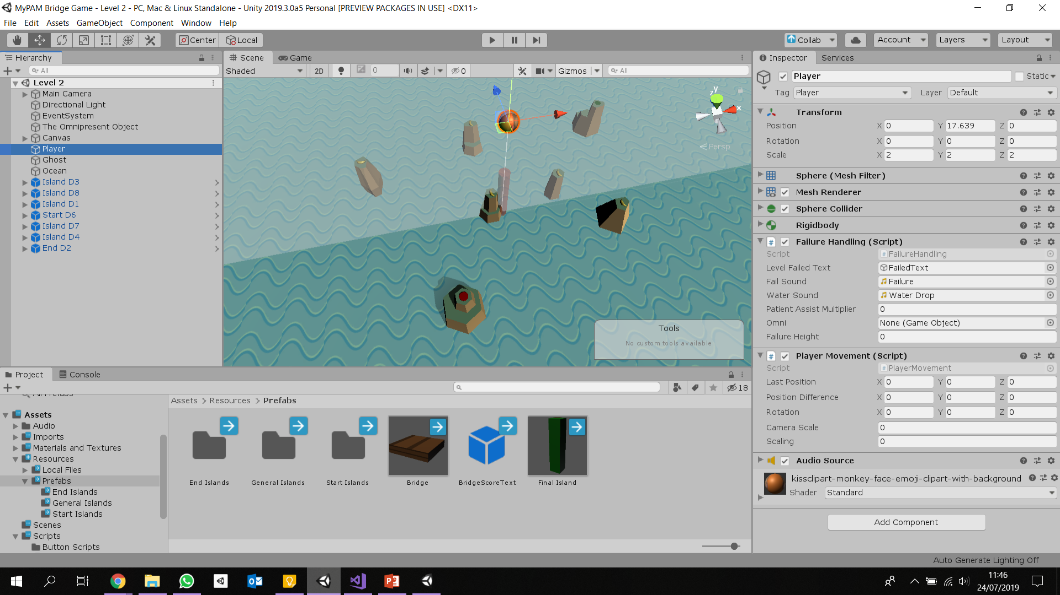
Our Tasks
Mid-Level Controller
Prototype myPAM compatible computer games
Game Development Library
Notes:
Mitchell: Over the summer my goal is to develop the mid-level controller that communicates between the games and the hardware.
Will: Our goal was to develop prototypes for myPAM games using Unity, then create a package that will help future developers easily create more games that are compatible with myPAM.

Slide 4
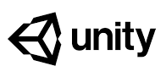
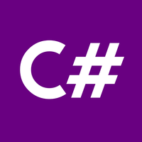
Initial Work
Learning Unity
Learning C#
Understanding UDP
Literature review
Notes:
Will: At the start of the project we had to learn the development tools and language we would be using – Unity and C#.
Unity is great because its pretty easy to pick up and start working with, and it provides a load of tools and features that makes development easier.
Mitchell: I also had to look into how UDP – the communication protocol selected for the project – could be implemented
Will: There are papers online that we read through to get a better idea of how to develop the games we would be making

Slide 5
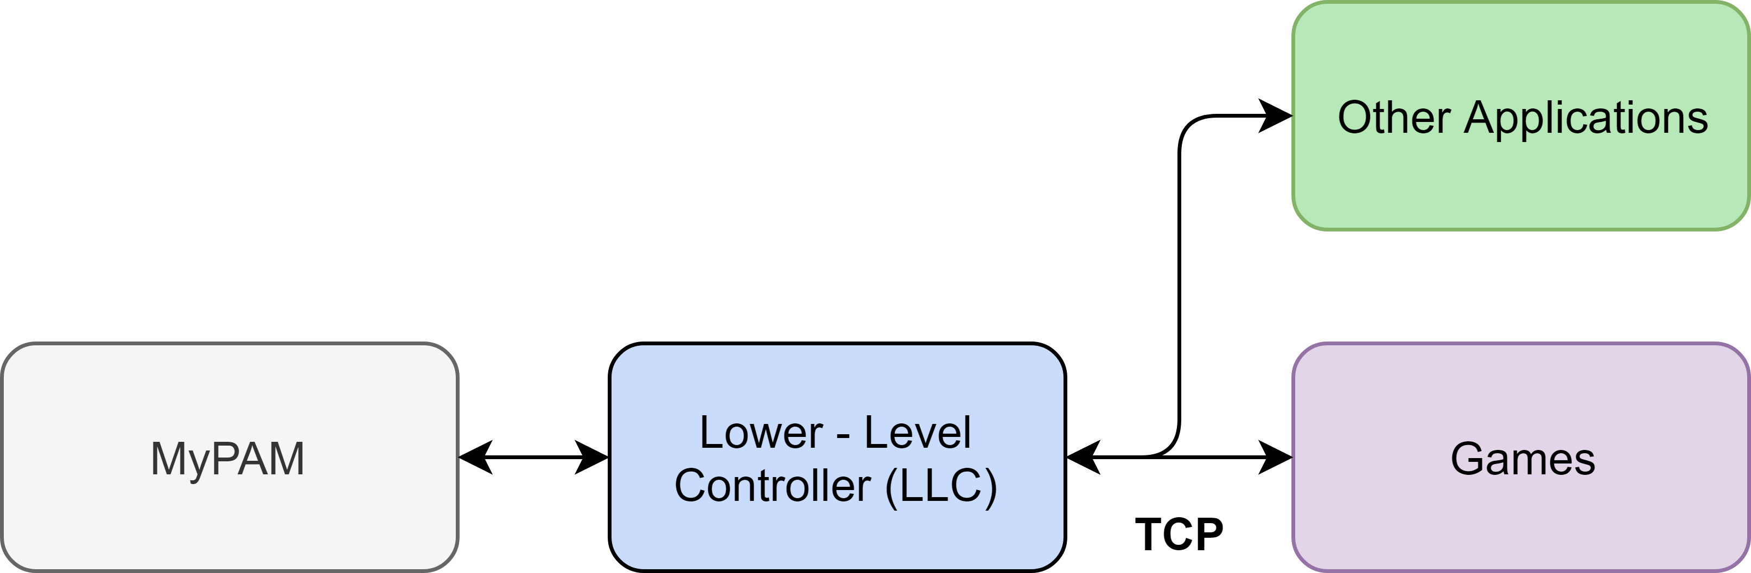
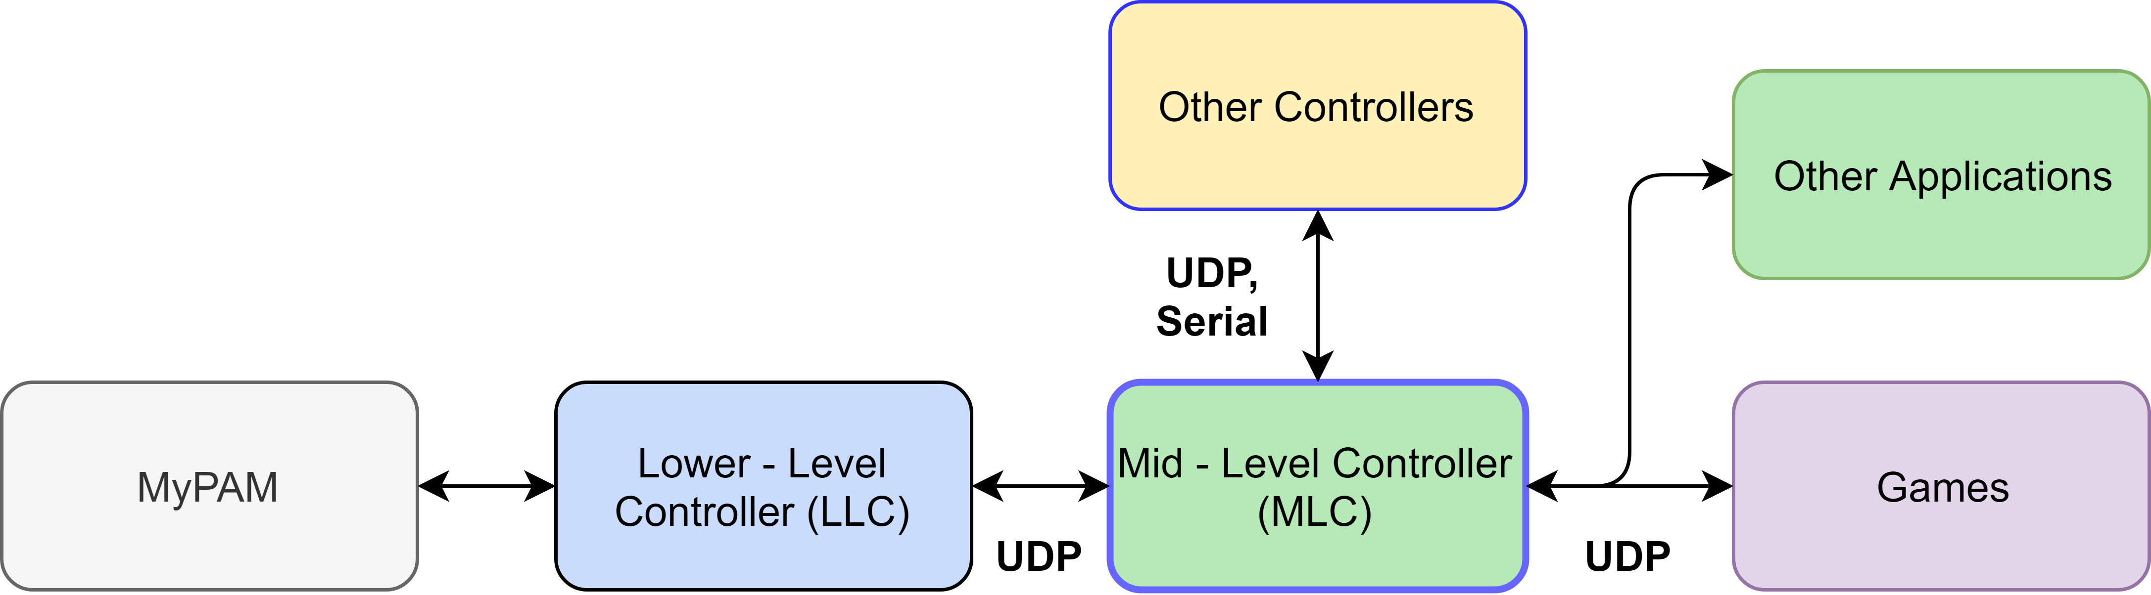
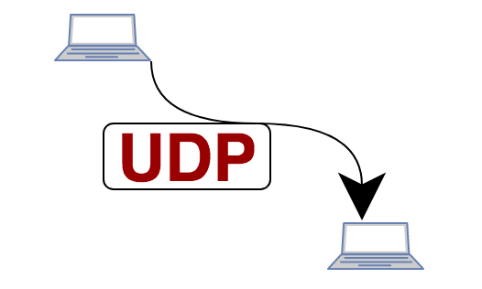

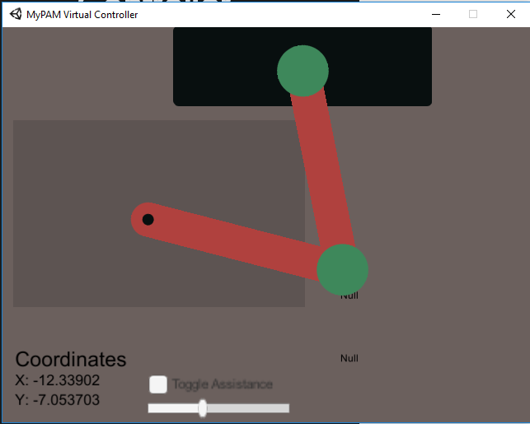
Mid-Level Controller
Old
Hub to for extra applications
Old system is unreliable
Data Transfer via UDP
Simulated MyPAM for game developers and testing.
New
Notes:
My job was to create the mid level controller. The midlevel controller acts as a hub that other applications can easily be attached and detached to and from. For example the user can decided where the system is in developer mode or patient mode. If it is in developer mode the user can select what controller they wish to use, they can use the MyPAM or if the don’t have access to it they can use a virtual controller which I made to simulate the MyPAM on a desktop application or their own joysticks.
Another reason for adding a mid level controller is because the old system was unreliable. If a game crashed the MyPAM would react unpredictably which is unsafe for the user. This was due to the games and the MyPAM being coupled together via a TCP connection. Somewhat ironically to decouple the system and make it more reliable we switched from using TCP to UDP. UDP is faster that TCP but also less reliable so we made the system less reliable to make it more reliable. But I will take about why that makes sense.

Slide 6
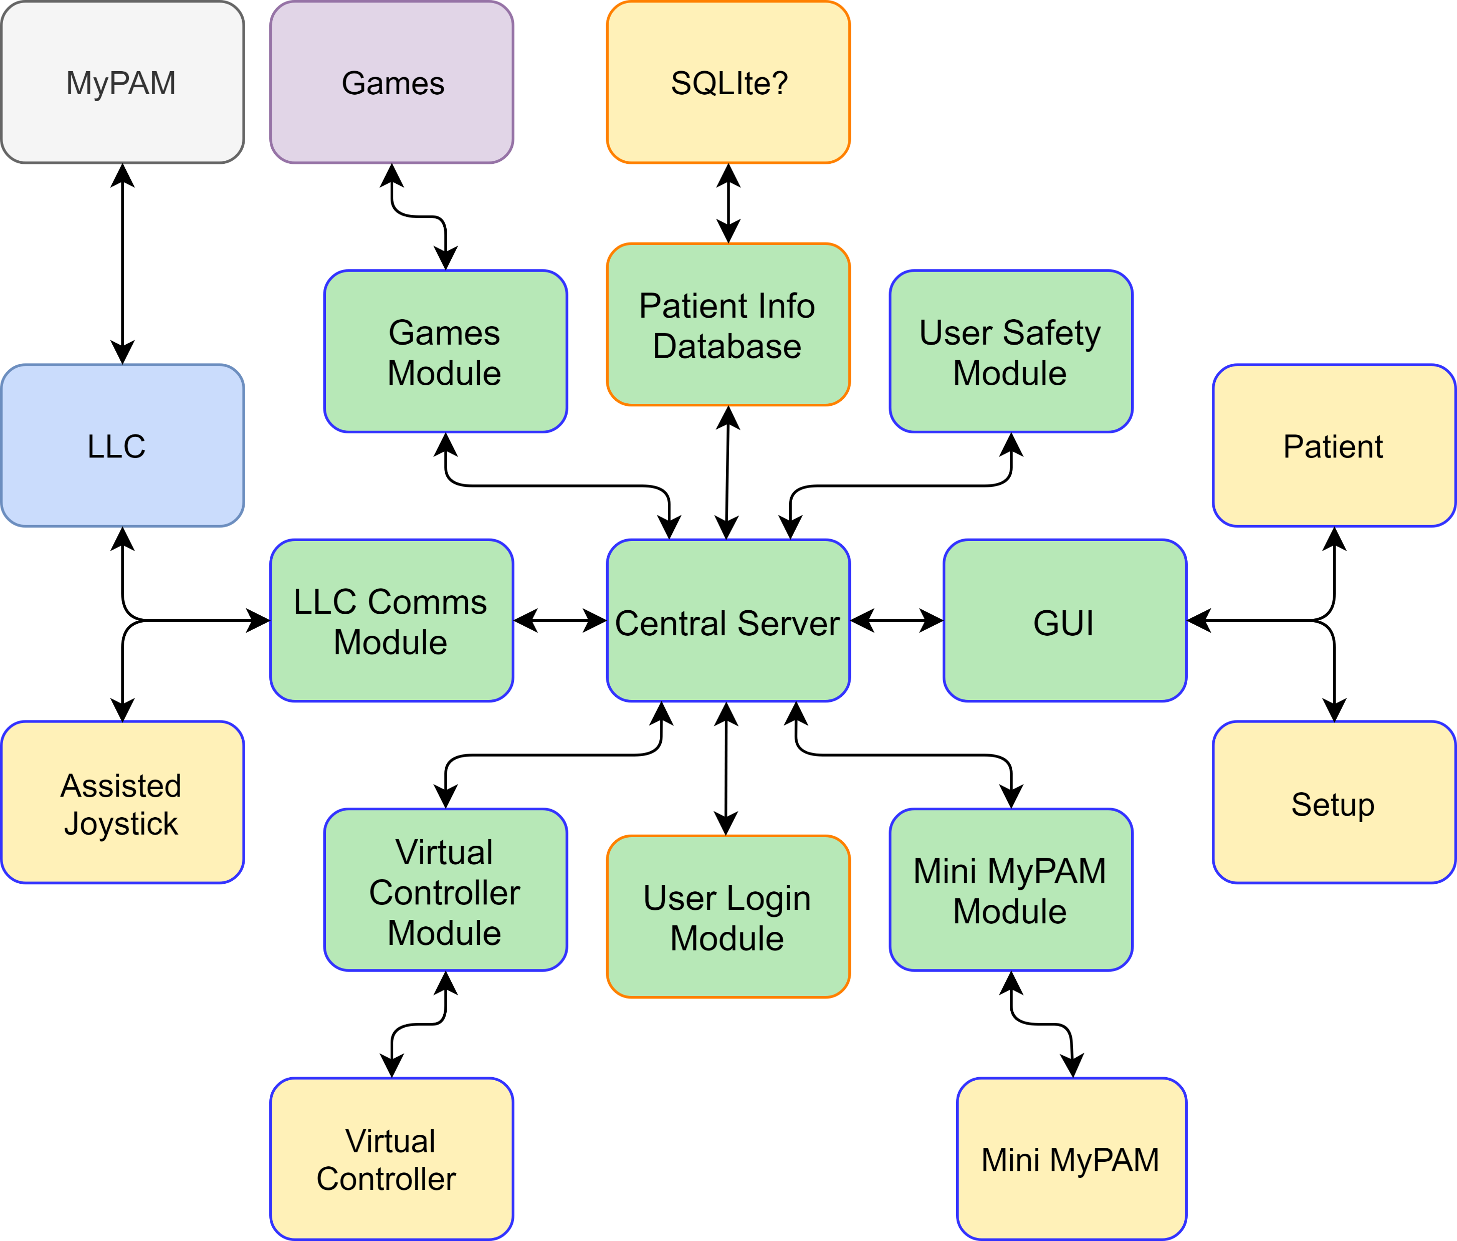
Mid-Level Controller
Modular Design
Communication between modules is done via UDP.
Connection loss detection.
Notes:
What you can see in green is my midlevel controller as it stands. It is a module design so applications can be added and removed easily. Each module is its own program and they communicate via UDP. The reason I made each module its own program is again to decouple which means if one of the modules, game or controller was to crash my controller can detect that and act accordingly which is done via the user safety module.
As to why we switched to UDP. Before the speed of the controller and games was limited to speed data could be transferred between the two. Now they are communicating via UDP which is fire and forget. So the game and controller can run as fast as they like and periodically send out data without needing to receive any data back. My midlevel controllers job is to sample the data being sent from both the controller and the game and transfer that data. There isn’t exactly an acknowledgment protocol in my midlevel controller but it can detect when data is not being received at which point it can spoof the controller or game to safely end the session for the user.

Slide 7
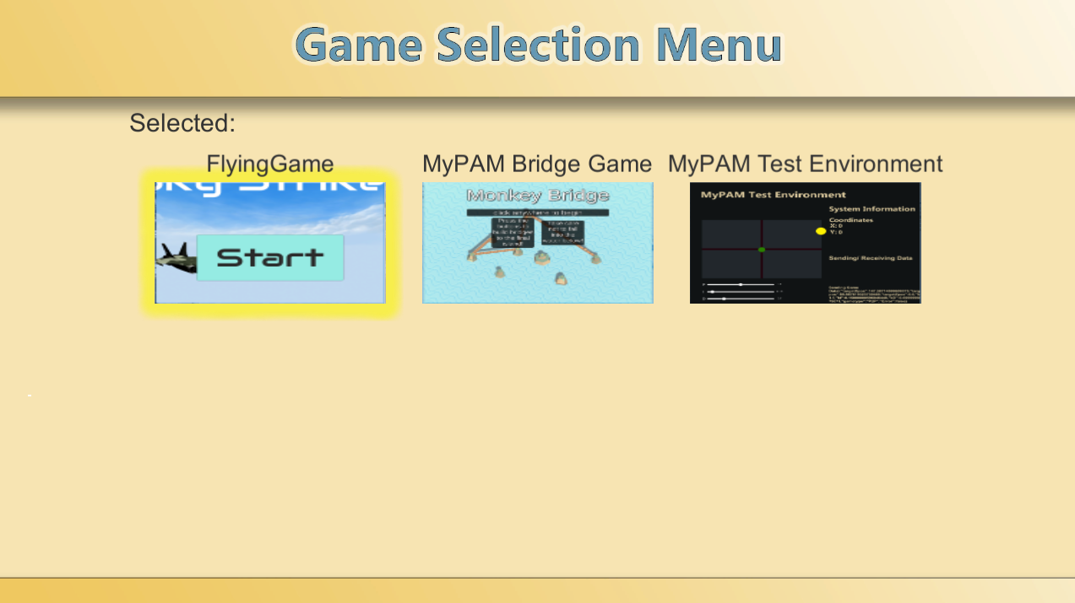
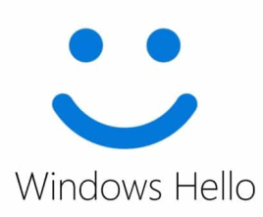

Next Steps
Test system on MyPAM
Improving patient usability
Add patient info database
Add user login module
Notes:
My next step are to test the system on the official MyPAM making sure everything works as planed. Then improve patient usability they only time the patient will ever see my project is when they select a game because the user will only be able to use a single button to chooses a game it can make it challenging when deciding what the best method is. And I’m terrible at art, that was my best attempt after 1 and a half hour in Photoshop so I plan to out source. If any one is good at art in here I will give you my email.
Once the game selection menu is completed then I will be adding patient databases to store information about the patient and their progression. Finally I will be adding a user login module for when one device has multiple users.
The plan is currently to use facial recognition via windows hello because they user may not be able to type and it is cool.

Slide 8
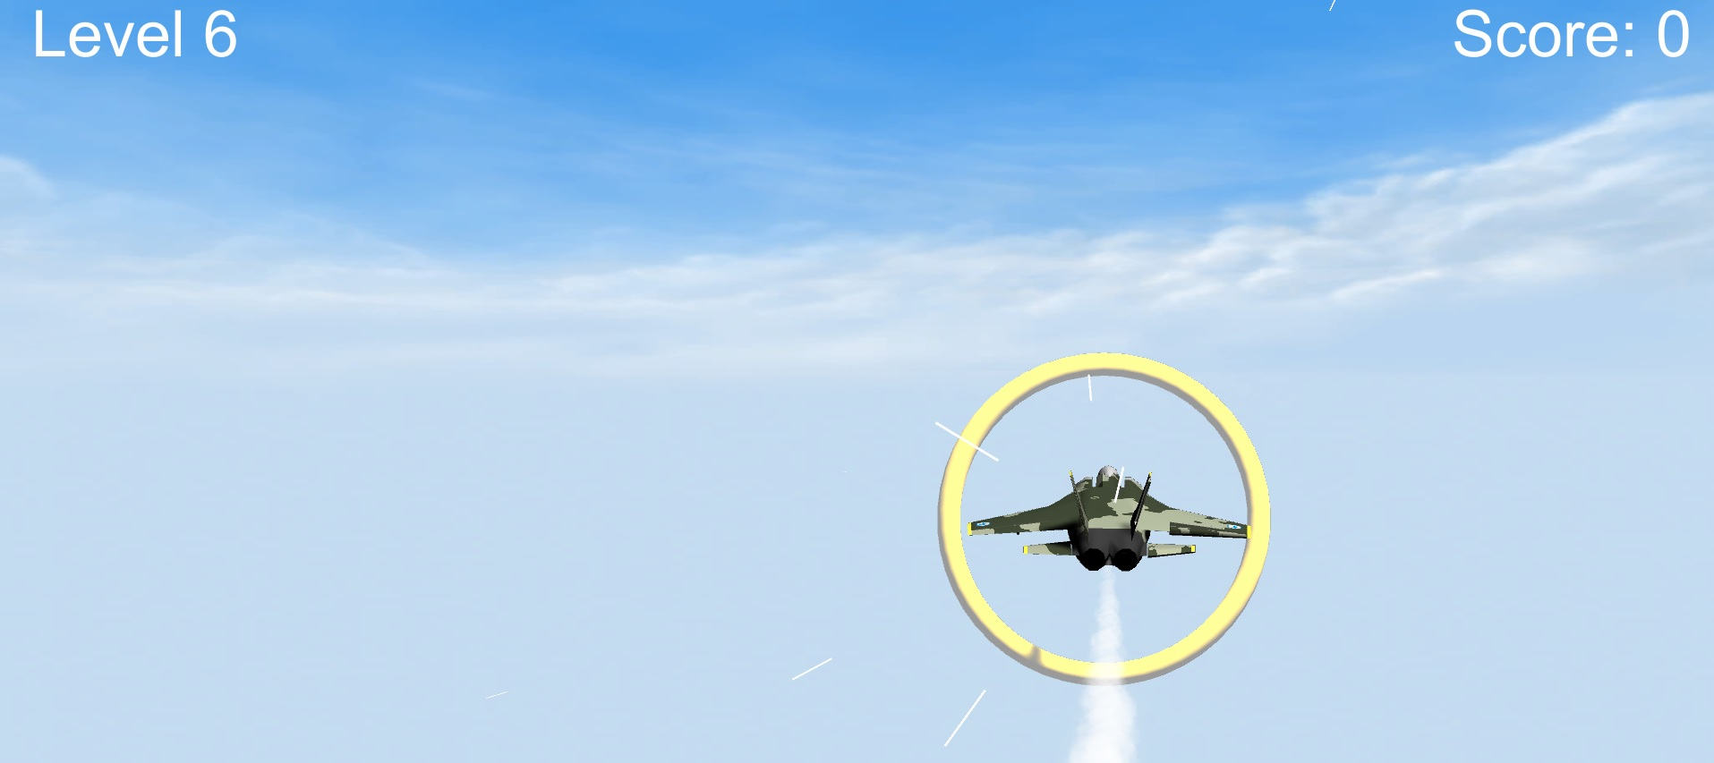
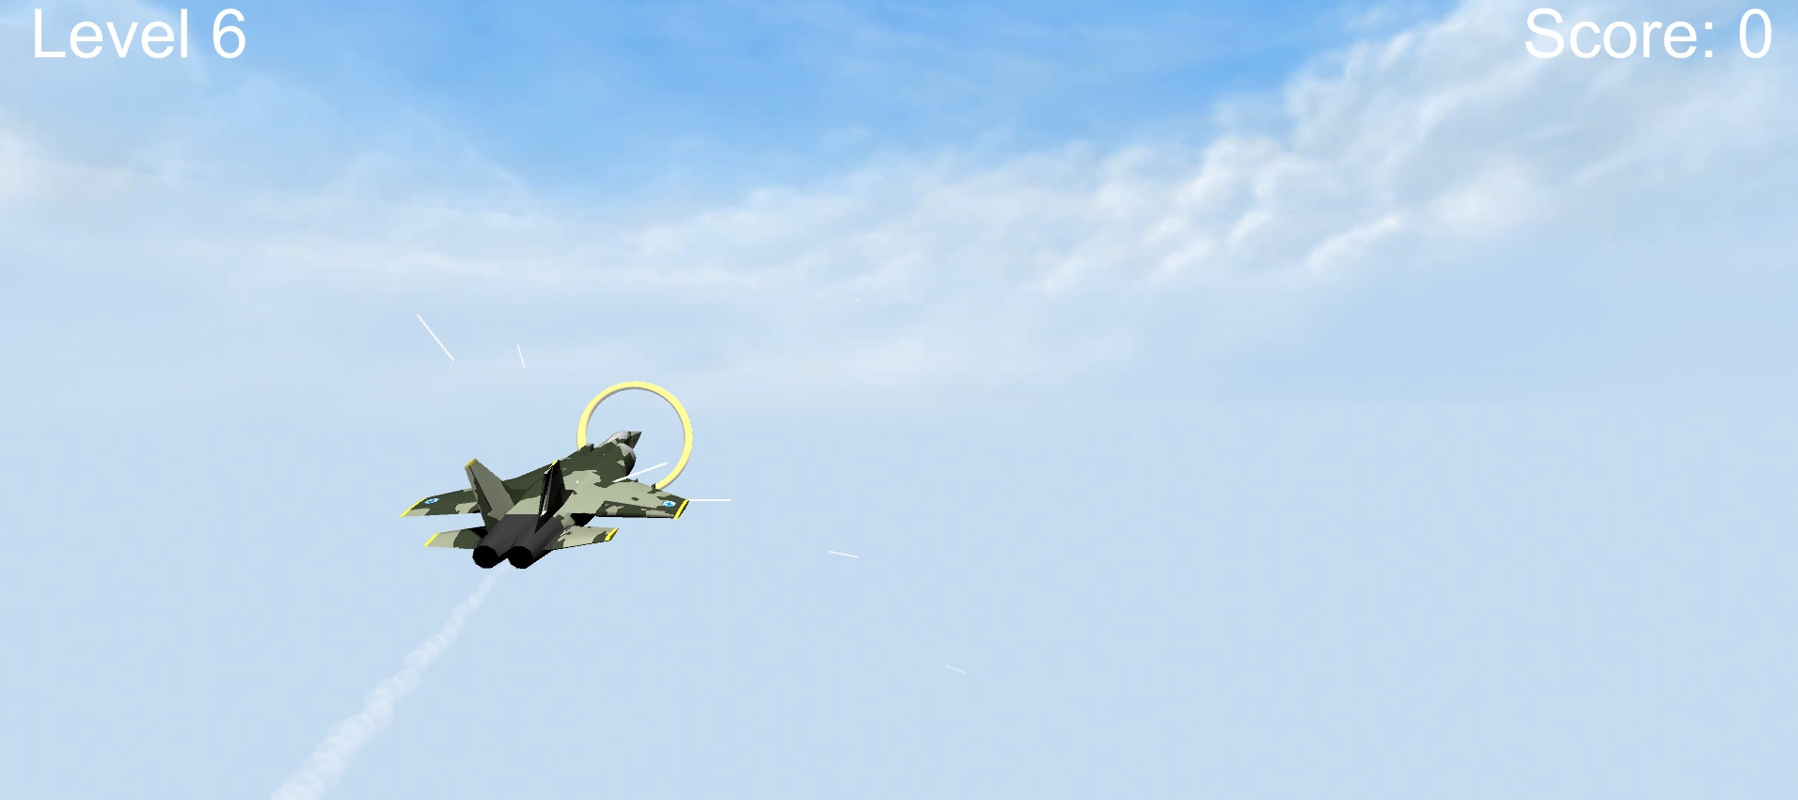
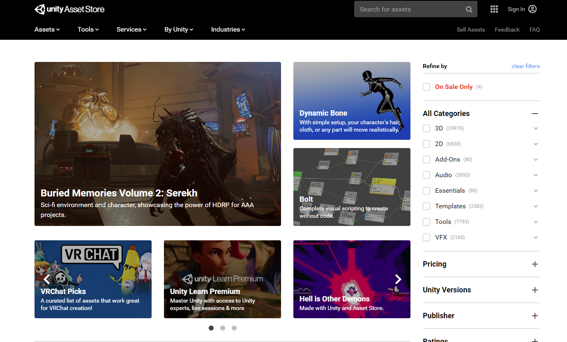
Flying Game
2D vs 3D
Orthographic vs Perspective
Free assets

Slide 9
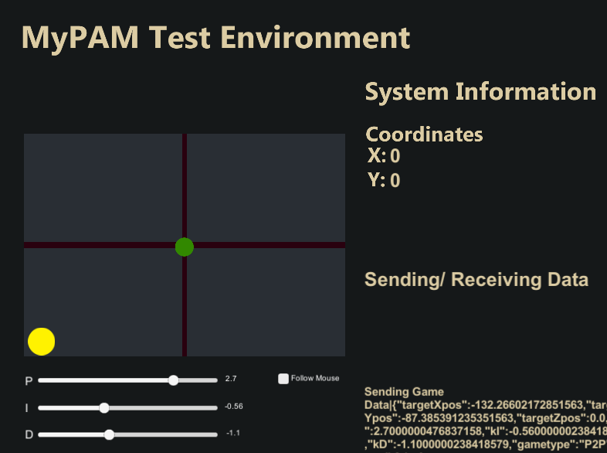
Design Limitations
Point to point
Curved trajectories
Exercises for independence

Slide 10
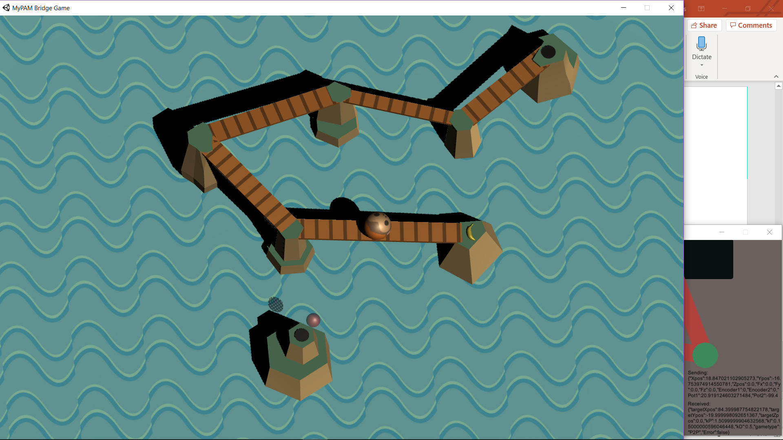
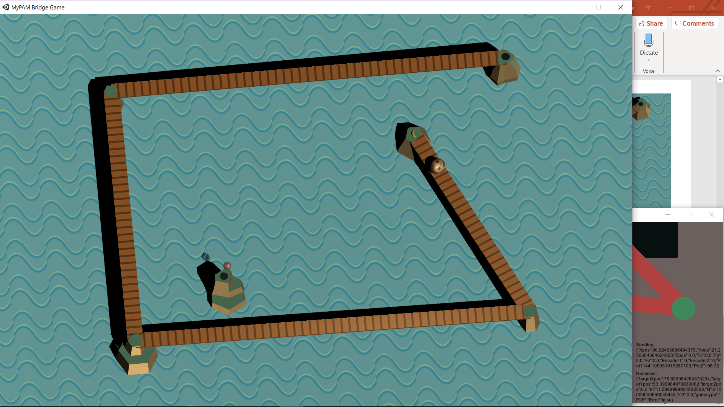
Bridge Game
Point to point
The patient plays as a monkey trying to collect all of the bananas
Ghost of previous attempts races the patient
Data saved locally
Notes:
So far I’ve also created a point to point game, where a monkey travels between islands collecting bananas.
Finding a banana gives them points based on how steadily they crossed the bridge, and a new bridge appears to the next banana.
If the patient has completed the level previously, a ghost will appear and copy their best attempt exactly, giving the patient a visual benchmark of how they are hopefully improving. This should
give motivation to the patient, urging them to improve. It hopefully also motivates them to replay the game at least once, doubling the time they spend performing these muscle movements.
The ghost is controlled by following coordinates saved in a csv file. Other data is saved to different files such as session timestamps, attempts at each level, and in future the score with each completion. A lot of this data will be put on the server so the therapist can review it. For example, if the patient struggled with a particular level the therapist can review the level and see if it’s a specific movement they are struggling with, and then perform some specific exercises next time they see the patient.

Slide 11


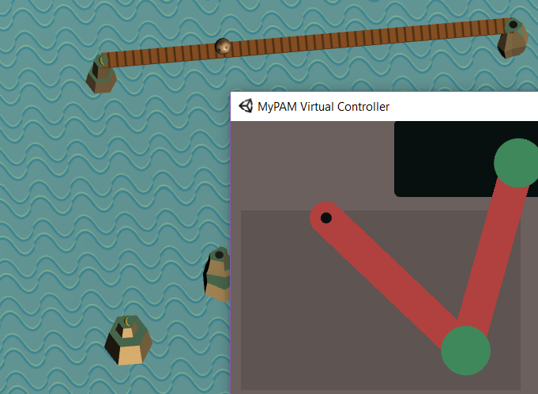
Design Considerations
Art style
Camera Angle
Game design with no player choice
Notes:
As with any game, there are a lot of possibilities for a lot of different design factors. These considerations become even more important when developing for a specific purpose such as rehabilitation.
The art style has to look consistent, fun, and can’t take too long to create since we have limited time. The asset store on Unity has loads of free assets, so I have used a package for the islands which provided a variety of shapes with different textures, like dirt and rock, which will let me create variations with future levels. I couldn’t find a texture for the bridges or water that wasn’t too detailed so ended up drawing them myself. The textures are 1 unit by 1 unit and Unity lets you easily tile them to create a repeating pattern.
The camera angle is currently rotated 5 degrees because it looks better, however the position of the monkey won’t directly relate to the position of the joystick, so I have to consider if this will reduce the effectiveness of the rehabilitation. Patients may get confused if their physical movements aren’t directly related to the visual movement it causes.
Again, since the myPAM needs to know the next position, there is very limited player freedom. The source of fun for this game is the test of how accurately and quickly you can complete each level.

Slide 12
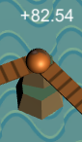
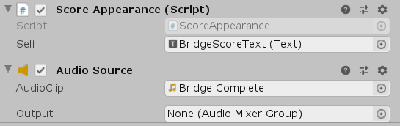
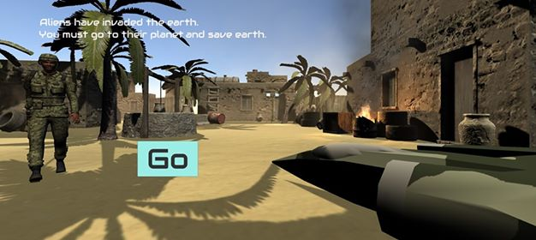
Accuracy based scoring with cheerful sound effect
Future Work
Reward
Optimal challenge
Feedback
Choice/interactivity
Clear goals and instructions
Socialisation
A story line provides motivation to play the game to the end
Notes:
The main paper we looked at outlined 6 key features in a computer game that increase player engagement.
Will: The paper gives four main conditions that computer games should trigger to reward players. Currently, the bridge game only does one of these –the use of stimuli. I need to look into ways of engaging the other four conditions – Decisions, Uncertainty, and Exploration/novelty.
Helcias: Its hard to optimise game difficulty. Our current method is to have the games start simple and increase in difficulty as the patient progresses. Ideally, this will match difficulty to their improving capabilities. Testing and user feedback will be needed to improve this.
Will: Feedback is mainly provided with visual effects, sound effects, and score systems. In the bridge game the ghost provides an indication of the patient’s progress as they hopefully complete the level faster the second time round.
Mitchell: Future games may be able to solve the problem of player freedom. Almost 80% of stroke patients suffer hemiparesis, which is a weakness in one side of the body, meaning the other side should be strong and dextrous enough to control simple inputs. We currently plan to provide a single extra input to keep things simple for the patient.
Will: The flying game has a storyline which gives the patient an overall goal and motive for completing the game. The bridge game currently does not have an overall motive to encourage the completion of the game. This is something I need to work on.
Both of these games are single player. There are plans to develop the system so that two players with different levels of assistance can play certain games with each other in a fair, cooperative manner.

Slide 13
Future Work
Improving current prototype games
Level creation tools
Creation of a library for future game developers
Any questions?
Notes:
In the next few weeks we will be getting these prototype games finished. We will be reviewing our progress so far, getting feedback, and then re-examining the game design principles that will make them optimal for rehabilitation.
The bridge game currently only has a couple of levels. I am currently working on a way for anyone, such as the therapist, to easily create new levels without having to edit the game files. At the moment it takes a csv file in excel and turn that into a level, but eventually I want to generate that csv file with another application.
We also want to make it easy for future developers to create compatible games, so will be creating a library and documentation. An example of what this will include is the script for communication between the game and the mid-level controller. Currently, its as simple as creating a gameobject in Unity, attaching the UDP Communication script, and attaching a script that makes it persist between level loading. There are gets and sets in the script for accessing variables such as joystick x, y, and z.

